Slide 1
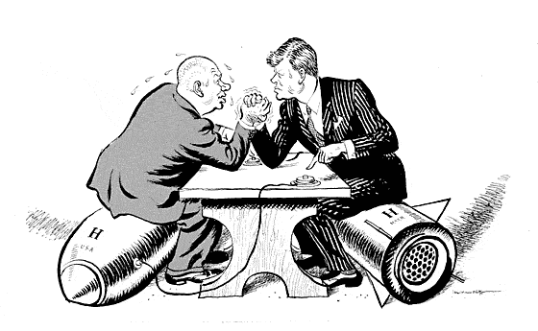
Aim:How did the cold war affect Cuba?
Do Now: What’s the Message?
HW: Write a paragraph discussing whether or not
You would have handled the situation differently than
President Kennedy?

Slide 2
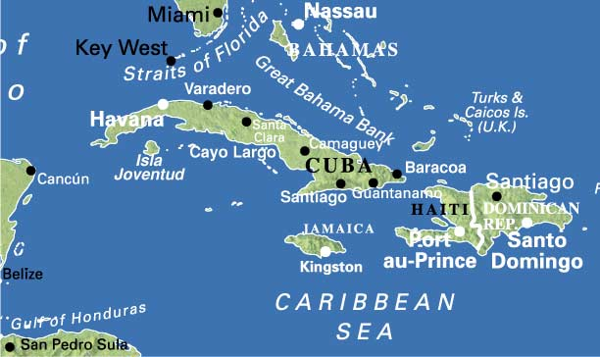
Cuba is 90 Miles from the Florida Coast
A Soviet “Client-State”

Slide 3
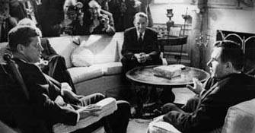
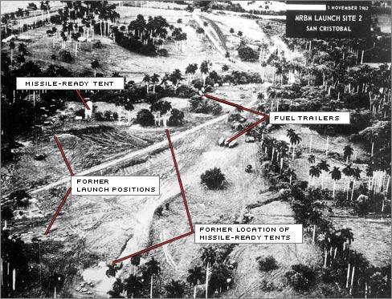
The Cuban Missile Crisis: October, 1962
Cuba was caught in the middle between the US and Soviet Union. After the US put nukes in Turkey, the Soviet Union put nukes in Cuba. This is the closest the US and Soviet Union ever came to nuclear war. Soviet Union agrees, after intense pressure to remove the missiles.

Slide 4
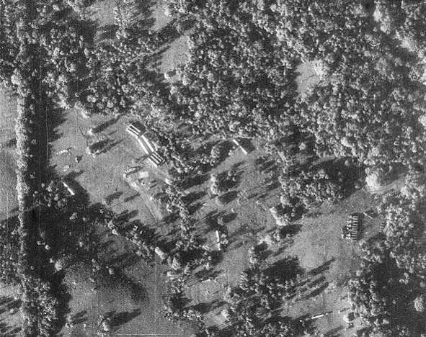
Soviet-Cuban Construction

Slide 5
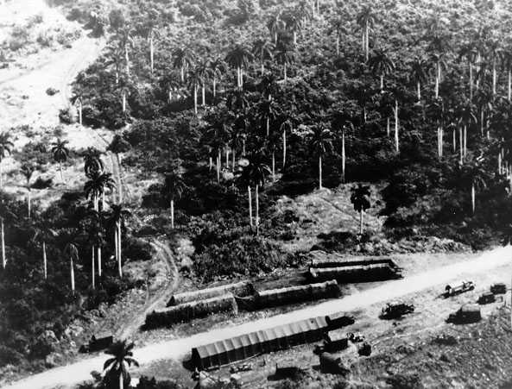
Soviet-Cuban Construction

Slide 6
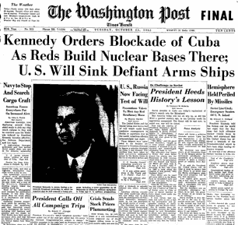
Global Thermal Nuclear War?

Slide 7
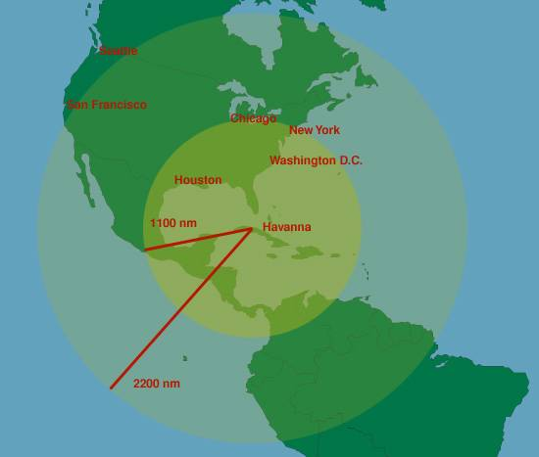
Range of the Cuban Missiles

