Slide 1
Introduction to Ideologies
Social Studies 30

Slide 2
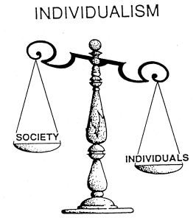
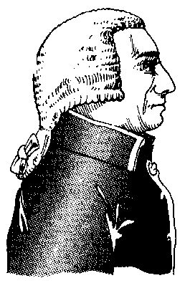
Collectivism vs. Individualism
Individualism:
Those who claim that people should be primarily concerned with satisfying their own personal interests and goals.
Individualism also emphasizes the notion that persons should act on their own to accomplish their goals (self interest).
People are motivated to satisfy personal goals
People act on their own to satisfy their own goals
Belief that society’s welfare is provided for when individuals assume responsibility for themselves
Government plays a limited role – Adam Smith called for ‘laissez faire’
Personal initiative, profit motive and self interest are individualist

Slide 3
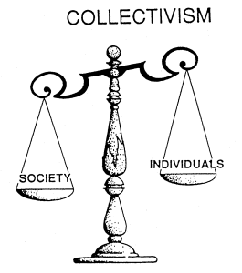
Collectivism vs. Individualism
Collectivism:
Those who believe that the goals of society should be emphasized.
Collectivists believe that people function best by acting as part of a larger group. Collectivists are concerned about providing security for all people.
Emphasis is put on society’s goals
People are held to function best as part of a group
Provision should be made for the security of all individuals
People are seen as needing help
Society’s resources should be coordinated collectively
Gov’t plays an extensive role, acting on behalf of the people
Karl Marx contributed to the collective ideologies of socialism and communism
Collectivists emphasis equality or egalitarianism

Slide 4
Collectivism vs. Individualism
To what extent should we embrace an ideology?
Curricular Outcomes
1.7 analyze individualism as a foundation of ideology (principles of liberalism: individual rights and freedoms, self-interest, competition, economic freedom, rule of law, private property)
1.8 analyze collectivism as a foundation of ideology (principles of collectivism: collective responsibility, collective interest, cooperation, economic equality, adherence to collective norms, public property)

Slide 5
Evolution of Liberalism

Slide 6
Evolution of Liberalism

Slide 7
Evolution of Liberalism

Slide 8
Evolution of Liberalism

Slide 9
Evolution of Liberalism

Slide 10
Evolution of Liberalism

Slide 11
Evolution of Liberalism

Slide 12
Evolution of Liberalism

Slide 13
Evolution of Liberalism

